Slide 1
Non Recursive Predictive Parsing
LL(1) Parsing Table Construction and Parsing an input string

Slide 2
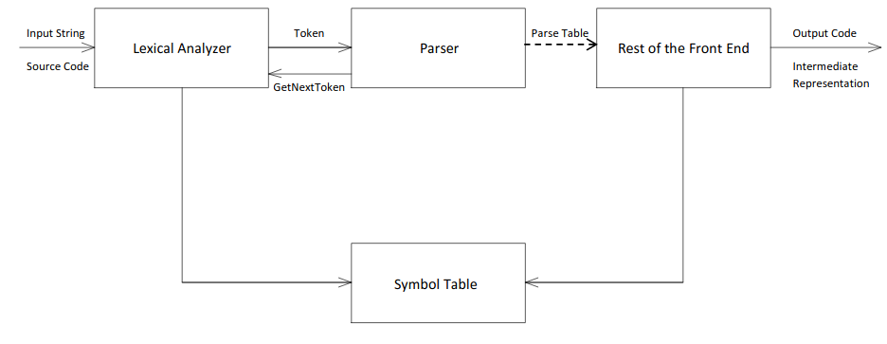

Slide 3
Parser
check tokens coming from the lexical analyzer
verify that the string can be generated by grammar
responsible to report any syntax error it encounters during parsing

Slide 4
Types of Parsers
Universal Parser: It can parse any kind of grammar. Cocke-Younger-Kasami Algorithm and Earley’s Algorithm
Top-down Parser: It builds parse tree from top (root) to the bottom (leaves). A parse tree is an ordered rooted tree that represents the syntactic structure of string according to some formal grammar. Examples of top-down parsers are: LL Grammar, Recursive Descent, and Non-Recursive Predictive Parser.
Bottom-up Parser: In this parser, the parse tree is built from the bottom (leaves) to the top (root). Examples of bottom-up parsers are: LR/SLR, CLR, LALR, Shift-Reduce,Operator Procedure Parser

Slide 5
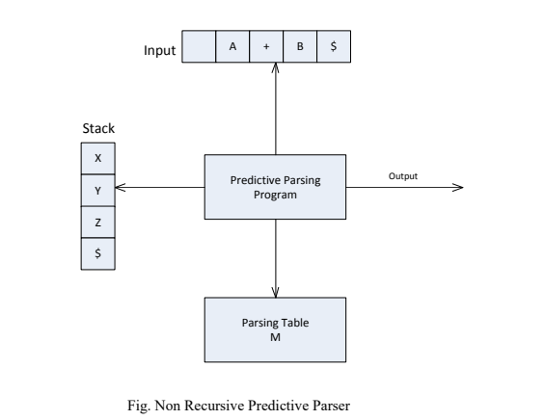
Non-recursive predictive parsing
can be build by maintaining a stack explicitly.
Key problem encountered during predictive parsing is to determine the production to be applied for a non terminal.

Slide 6
Behaviour
The program considers X, the symbol in top of stack, and a, the current input symbol. These two symbols determine the action of the parser. There are following three possibilities:
If X=a=$, then parser halts and announces successful completion of parsing.
If X=a $, the parser pops X off the stack and advances the input pointer to next input symbol.
If X is a non-terminal the program consults entry M[X,a] of the parsing table M. this entry will be either an x-production of grammar or an error entry

Slide 7
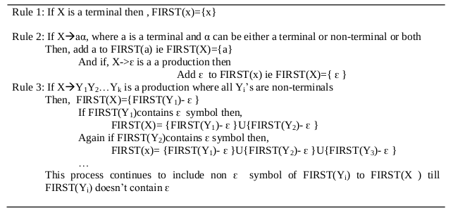
Calculation of FIRST
The first set of a sequence of symbols u, written as FIRST(u) is the set of terminals which start the sequences of symbols derivable from u.

Slide 8
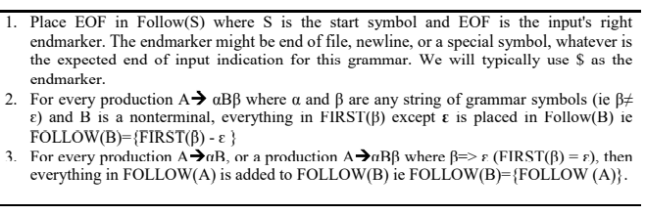
Calculation of FOLLOW
The follow set of a nonterminal A is the set of terminal symbols that can appear immediately to the right of A in a valid sentence.

Slide 9
Algorithm to Fill Parsing Table
Input: Set of FIRST and FOLLOW elements along with Grammar G
Output: Parsing Table M
Method: We check for every production of the form A->alpha, the FIRST (α). If it contains ԑ then add the production to M[A,a]. Else add each element of FOLLOW(A) in M[A, b].

Slide 10
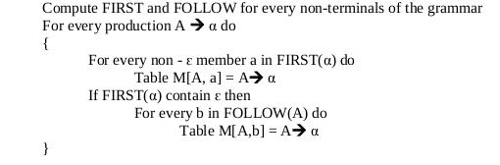

Slide 11
Algorithm for Non Recursive Parsing
Input: A string w and a parsing table M for grammar G.
Output: If w is in L(G), a leftmost derivation of w; otherwise and error indication.
Method: Initially, the parser is in a configuration in which it has $S on the stack with S, the start symbol of G on top; and w$ in the input buffer. The program that utilizes the predictive parsing table M to produce a parse for the input is shown as:

Slide 12
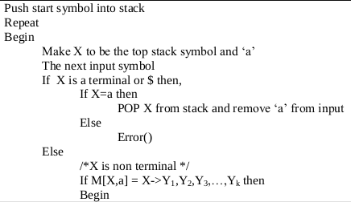
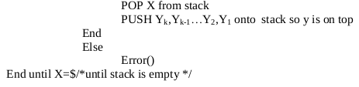

Slide 13



Implementation
The grammar given to design the parser was:
In order to generate a non-recursive parser, we had to remove any left recursion if was available using the following rule.
Removing Left Recursion:
Hence the production rule that was used in the program was modified to:
where E represented epsilon and K represented B’.

Slide 14

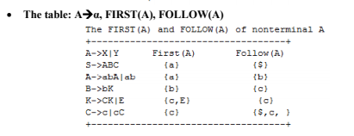
Output:
Using the user defined modules; we can obtain the following result for the non-recursive predictive parser.
The Grammar:

Slide 15
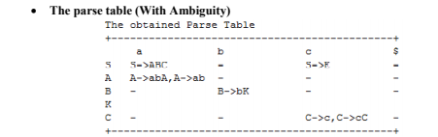
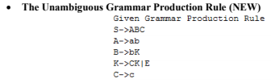

Slide 16
Conclusion
The program implements a simple non Recursive Predictive Parser.
The program uses a static production rule (both unambiguous/non-recursive grammar) and hence the FIRST and FOLLOW is limited to the given symbols only.
The program can parse the table limited to these symbols but can be done effectively for others too.
The input symbol can be changed statically or changed to ask for dynamic inputs programmatically for the parsing process.

